Slide 1
Cost Recovery Review 2026/27 Sector webinar
16 February 2026

Slide 3

Topics
Explain the costing model and principles
Outline the key elements of the draft Cost Recovery Implementation Statement (CRIS)
Invite feedback submissions
Housekeeping
Session will be recorded and published on our website
We will address your pre-submitted questions
Q&A function can also be used to lodge questions throughout this session

Slide 4


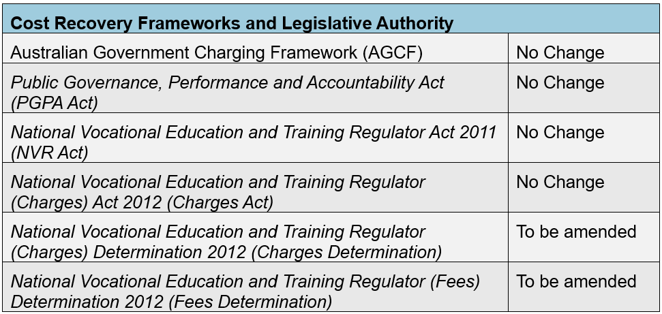
Cost recovery overview
ASQA is required to recover its costs

Slide 5
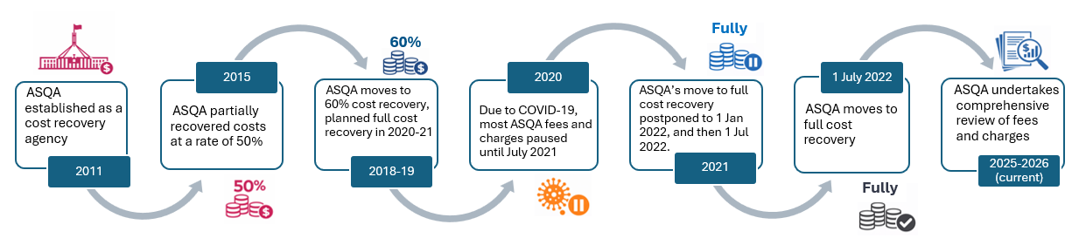
ASQA’s cost recovery history

Slide 6



Why review ASQA’s fees and charges now?
First comprehensive review since transitioning to full cost recovery in 2022
The review incorporates our:
improved operational processes & system efficiencies
increased appropriation and staffing levels
strengthened and expanded regulatory approach and activities
first indexation of ASQA’s fees and charges since 2022

Slide 7
Key changes at a glance
We are:
Realigning the Annual Registration Charge
Differentiating VET and CRICOS charges where appropriate
Moving from hourly rates to fixed fees for provider-directed activities
Adopting a scaled pricing approach to performance assessments and compliance pathways, incentivising effective and responsive compliance resolution by providers
Benefits:
Charges are more closely aligned to regulatory effort, ensuring fairness and proportionality
Providers are able to more accurately forecast their regulatory costs
Lower regulatory costs for highly compliant providers
Annual Registration Charge (ARC)
What is changing | What is not changing
Incorporation of costs associated with new sector wide activities and functions | Payable by all providers
Separate ARC for different provider types: NVR-only and CRICOS-only (ELICOS) providers NVR + CRICOS providers | Calculated on the size (enrolments) and scope (qualifications / units) of each provider
Incorporating providers delivering only units of competency and ELICOS-only courses. | The size and scope matrix to account for the diversity of the sector
Direct Fees and Charges
What is changing | What is not changing
Fixed pricing for applications and assessments | Separate application and assessment fees for initial registration, renewal and change to scope
Scaled pricing model for performance assessments and compliance pathways based on level of regulatory effort required | Reconsideration (internal review) fees
Separate charges for financial viability specialised assessments, student assessment validations and onsite performance visits | Non-recoverable costs under the Australian Government Charging Framework, such as ASQAs legal costs

Slide 8
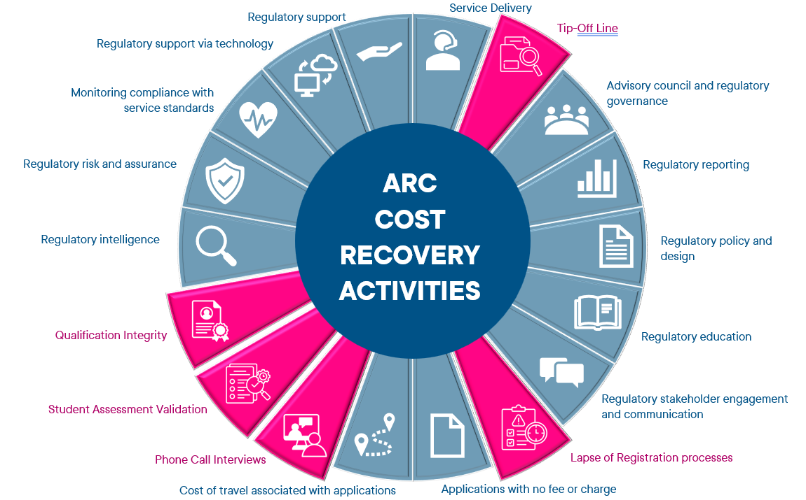
Annual Registration Charge (ARC)
Key changes
Different ARC amounts based on provider registration types (NVR RTO and CRICOS)
Inclusion of costs associated with new functions
Ratio-based calculation for providers that only have Units of Competency on scope
Incorporate ELICOS courses

Slide 9
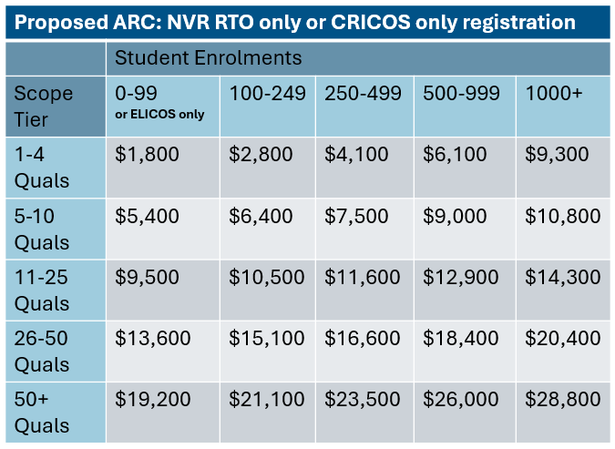
ARC example 1
NVR RTO only
An NVR RTO (domestic only) provider, has 8 qualifications and 21 units of competency on scope
They have 350 students
This provider’s ARC will be $7,500 in 2026-27
All costs listed are indicative

Slide 10
ARC example 2
ELICOS-only provider
An ELICOS provider has 12 qualifications on scope
Given student numbers are not used to calculate the ARC for ELICOS providers, they sit in the ‘0-99 students’ category.
This provider’s ARC will be $9,500 in 2026-27
All costs listed are indicative

Slide 11
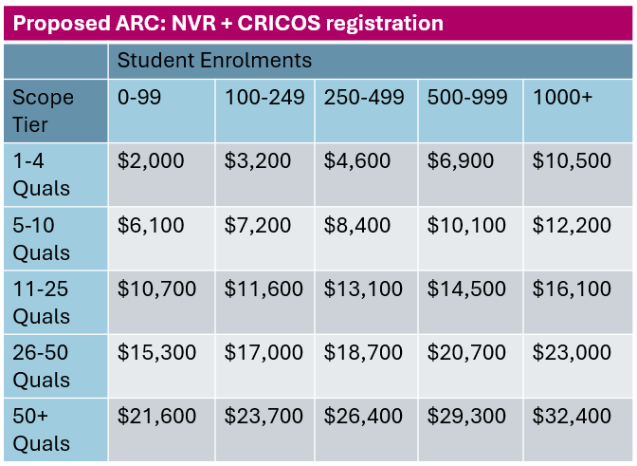
ARC example 3
NVR + CRICOS provider
An NVR + CRICOS provider has 6 qualifications on scope
They have 220 students
This provider’s ARC will be $7,200 in 2026-27
All costs listed are indicative

Slide 12

ARC example 4
NVR RTO with only Units of Competency on scope
A NVR RTO (domestic only provider) has 48 units of competency and no full qualifications on scope
They have 220 students
This provider’s ARC will be $6,400 in 2026-27
All costs listed are indicative

Slide 13








Entity directed, fixed fees
Fixed fees improve transparency
and clarity
Supports structured and consistent
performance assessments
Helps providers plan and budget
Reflects actual effort involved in
assessing applications

Slide 14
Entity-directed fees and charges
The following fees have been adjusted:
Initial registration application and assessment fees
Renewal (of registration) application fee
Amendment (change to scope) application fee
Course accreditation application and assessment fees
Renewal course accreditation application and assessment fees
Amendment course accreditation fee
Reassessment application and assessment fee
The following fees are being introduced:
Late renewal (of registration) application fee
On-site performance visit charge
Financial viability assessment charge
Student assessment validation charge

Slide 15
Deeper dive into provider examples

Slide 16


Renewal of Registration Applications
EXAMPLE:
An NVR RTO is due to renew their NVR registration.
A renewal application is submitted on time.
The provider will pay the:
Renewal of Registration Application Fee
Renewal of Registration Assessment Fee
Total
payable
$4,250
Application Fee
Assessment Fee
$1,250
$3,000
All costs listed are indicative

Slide 17

Change to Scope (one registration)
EXAMPLE:
An RTO wishes to add 4 qualifications and 2 units of competency to its scope of registration.
They submit 1 application
Total
payable
$1,300
Application Fee
Assessment Fee
Application limit
5 Qualifications
50 Uoc
$200
$1,100
All costs listed are indicative

Slide 18
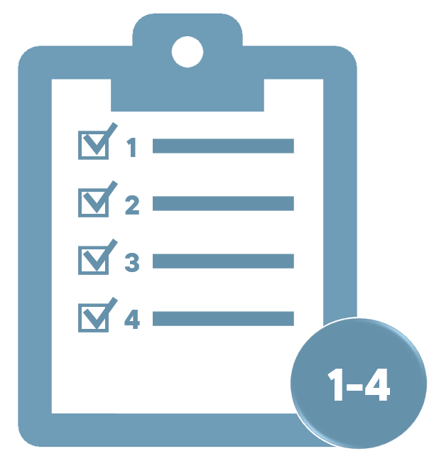
Change to Scope (two registrations)
EXAMPLE 2:
A provider that is registered under both NVR and CRICOS applies to add 4 qualifications to both scopes of registration for delivery to domestic and international students.
Application Fee
Assessment Fee
Application for
Qualifications 1-4
(NVR registration)
$200
$1,100
Total
payable
$2,600
and
Application Fee
Assessment Fee
$200
$1,100
Application for
Qualifications 1-4
(CRICOS registration)
All costs listed are indicative

Slide 19
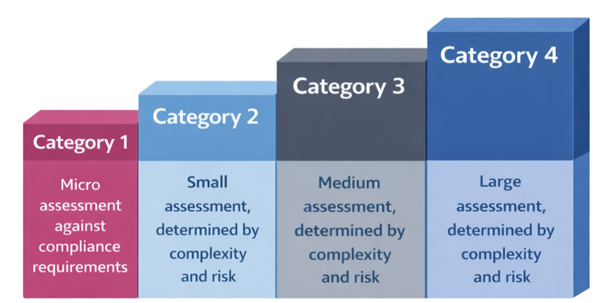
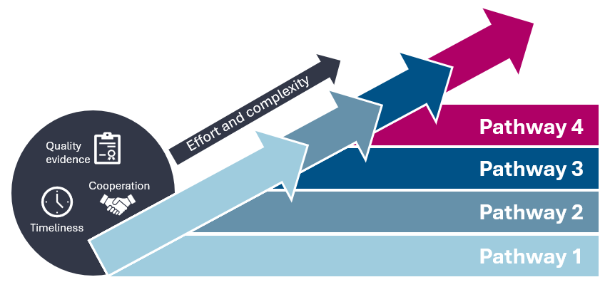
Changes to Performance and Compliance (Audits)
Performance assessment
Compliance resolution pathway
4 fixed charging categories
Reflect differing levels of assessment complexity and scope.
An assessment may be expanded to the next category if scope increases.
Ends with issue of an invoice
Fixed charges with 4 tiered pathways
Charges reflect the level of regulatory effort and complexity.
Providers enter at pathway 1 and are escalated until compliance resolution is reached.
Ends with issue of an invoice
$33,300
$22,250
$13,650
$ 6,650
$900
$4,000
$7,300
$11,700
All costs listed are indicative

Slide 20


Performance Assessment
Example
Performance Assessment Category 1
Performance Assessment
Category 1
Category 2
Category 3
Category 4
Provider fails to submit their Annual Declaration on Compliance (ADC) by the due date
A Category 1 Performance Assessment is conducted
Provider provides an ADC
Matter closed
$900
Invoice issued
Total payable
$900
End
Pathway 4
All costs listed are indicative

Slide 21
Performance Assessment & Compliance Resolution
Performance Assessment
Example
Performance Assessment Category 3 (due to size of assessment)
Category 1
Category 2
Category 3
Category 4
$7,300
Invoice issued
No non-compliances identified
Matter closed
Total payable
$7,300
End
Minor non-compliances are addressed by the RTO within a 20 day rectification period so they do not enter the Compliance Resolution Pathway
All costs listed are indicative

Slide 22



Performance Assessment & Compliance Resolution
Example
Performance Assessment Category 2
Performance Assessment
Category 1
Category 2
Category 3
Category 4
Non-compliance identified
$4,000
Invoice issued
Enter Compliance Resolution Pathway 1
Enter
Compliance Resolution
Does not resolve non-compliance within agreed timeframes
Quality evidence
Escalation
Escalation to Compliance Resolution Pathway 2
Cooperation
Pathway 1
Pathway 2
Pathway 3
Pathway 4
Timeliness
Ex
i
t
Non-compliance resolved. Matter closed
Total
payable
$17,650
$13,650
Invoice issued
End
All costs listed are indicative

Slide 23
Your Questions

Slide 24
Q1. How has ASQA considered the impact of the changes to cost recovery on smaller providers?

Slide 25
Q2. Performance Assessments
How will the model ensure better transparency of costs for those undergoing Performance Assessment?
Does every renewal application lead to a Performance Assessment (and therefore the associated charge)?

Slide 26
Q3. Is the Financial Viability Assessment Charge applicable to every Financial Viability Risk Assessment (FVRA)? Or are these different things?

Slide 27
Q4. What is the Complaint Investigation Charge? Is that new?

Slide 28
Q5. What is a Student Assessment Validation?

Slide 29
Q6. How will I be charged for activities that start before 1 July but don’t finish until after this new CRIS in place?

Slide 30

Still have questions?
More information available on our website
Use the QR code to submit your question – these will inform any additional guidance information to support the sector to be better informed about Cost Recovery and its impacts.
https://surveys.asqa.gov.au/n/9MrtkQB

Slide 31
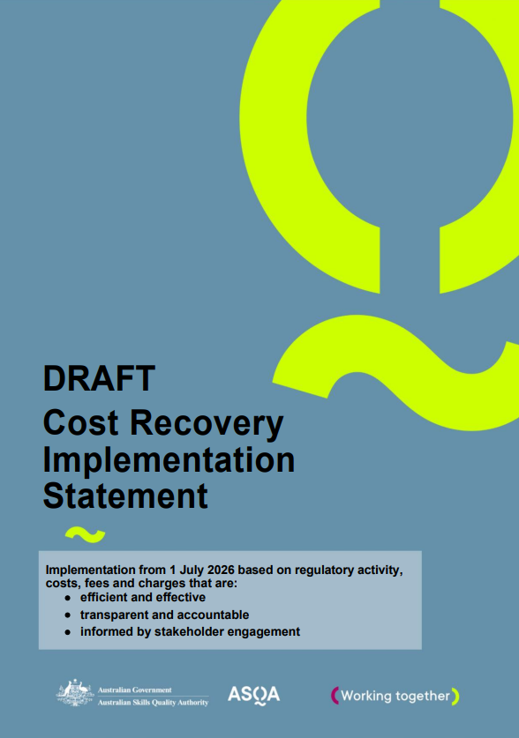
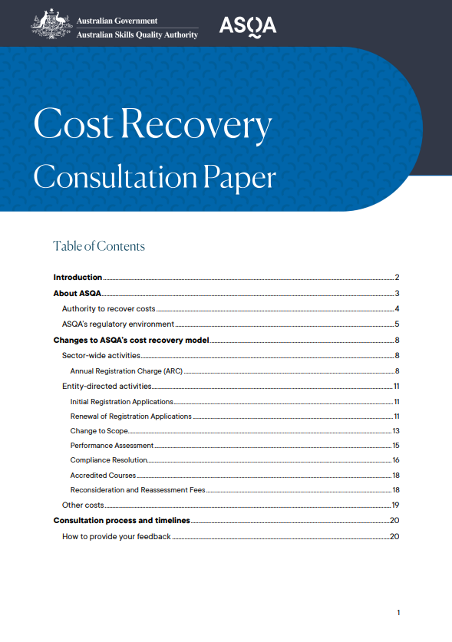

We want to hear from you
Consultation closes Friday 27 February 2026
Use the QR code below to go to our feedback form
More information available on our website
https://www.asqa.gov.au/about-us/fees-and-charges/consultation-on-fees-and-charges

